Slide 1
COURSE DETAILS Course: Database Management System(DBMS) Code : 18CS43 Sem : 4 Course learning objectives: 1. To discuss and realize the importance of Database Architecture Design notations, ER Modeling, Mapping and Schema design. 2. To gain the knowledge Relational algebra and learn the use of SQL and PL/SQL. 3. To introduce formal database design approach through normalization and discuss various normal forms. 4. To understand the importance of Concurrent Transactions and discuss issues and transaction control algorithms.

Slide 2
Course Outcome (Cos)
SNO | At the end of the course, the student will be able to, | Bloom’s Level
1 | Apply the database concepts and design database for given application scenerio | L3
2 | Apply the concepts of Normalization and design database which eliminates all anomalies. | L3
3 | Create database and develop database programming skills in SQL and PL/SQL. | L4
4 | Explain the issue of concurrency control in transaction processing. | L2

Slide 3
Text Books:
1. Elmasri and Navathe: Fundamentals of Database Systems, Addison-Wesley, 3rd edition and onwards.
2. Raghu Ramakrishnan and Johannes Gehrke: Database Management Systems, McGraw-Hill, 2nd edition and onwards.
Reference Books:
1. Silberschatz, Korth and Sudharshan: Data base System Concepts, Mc-GrawHill, 3rd edition and onwards.
2. C.J. Date, A. Kannan, S. Swamynatham: A Introduction to Database Systems, Pearson education, 5th edition and onwards.
E Resources:
3. PL/SQL study material.

Slide 4


Slide 5
Introduction to Database Management System
Data: facts that can be recorded and stored
Database:
A database is a collection of related data.
A database can be of any size and complexity.
DBMS:
A database management system (DBMS) is a collection of programs that enables users to create and maintain a database.
The DBMS is a general-purpose software system that facilitates the processes of defining, constructing, manipulating, and sharing databases among various users and applications.
Database System:
The DBMS software together with the data itself is database system.

Slide 6
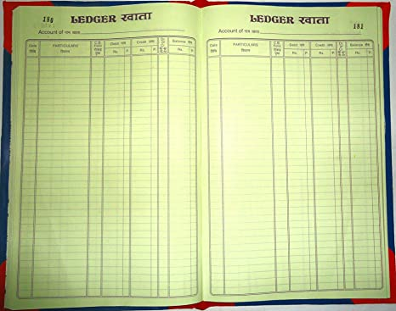

Create, Store, Maintain,& Share Data
Then
Now

Slide 7


A database can be of any size and complexity.

Slide 8
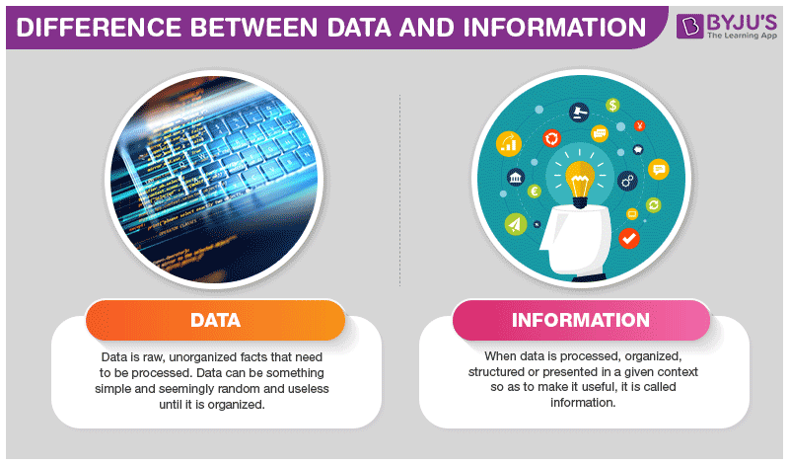
Data vs. Information

Slide 9
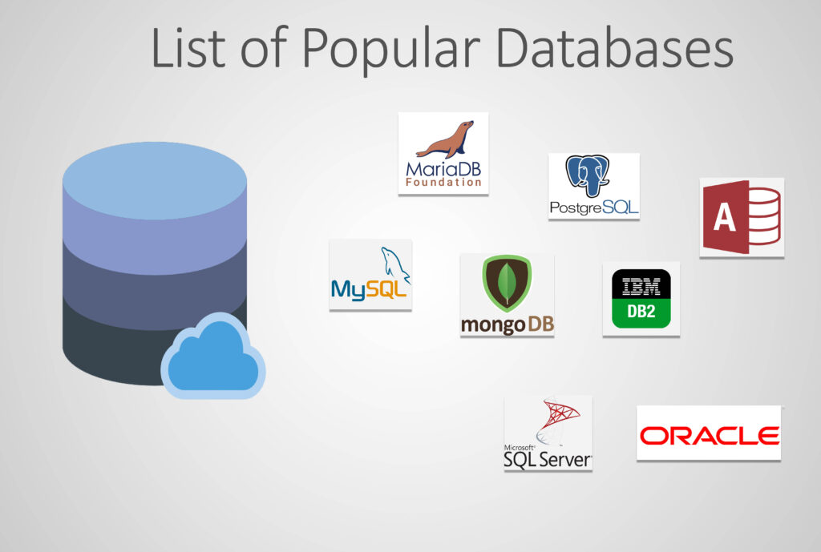

Slide 10
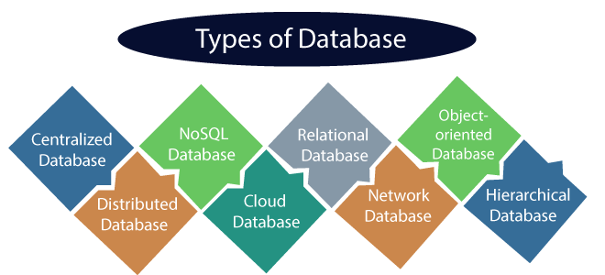

Slide 11
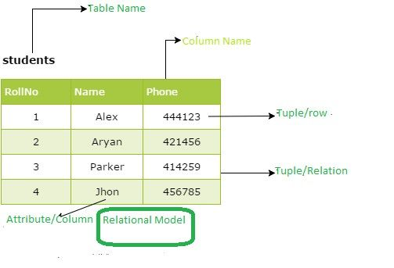
Relational Database(RDBMS)

Slide 12
Typical DBMS Functionality
Define a database : in terms of data types, structures and constraints
Construct or Load the Database on a secondary storage medium
Manipulating the database : querying, generating reports, insertions, deletions and modifications to its content
Concurrent Processing and Sharing by a set of users and programs – yet, keeping all data valid and consistent

Slide 13
Typical DBMS Functionality
Other features:
Protection or Security measures to prevent unauthorized access
“Active” processing to take internal actions on data
Presentation and Visualization of data to the end users

Slide 14
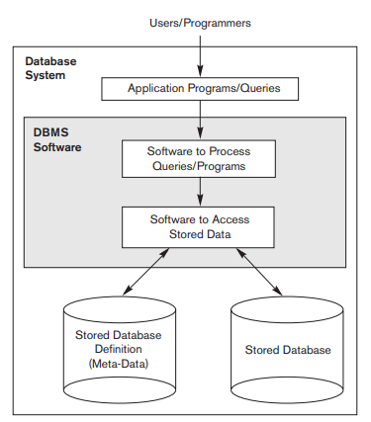
A Simplified Database System Environment.

Slide 15
Characteristics of the Database Approach
Self-describing nature of a database system
Insulation between programs and data, and data abstraction
Support of multiple views of the data
Sharing of data and multiuser transaction processing

Slide 16
1. Self-describing nature of a database system
The database system contains not only the database itself but also a complete definition or description of the database structure and constraints, which is known as metadata.
This metadata is stored in DBMS catalog and is used by the DBMS software and also by database users who need information about the database structure.
The DBMS software must work equally well with any number of database as long as the database definition is stored in the catalog.
In traditional file processing, data definition is typically part of the application programs themselves. Hence, these programs are constrained to work with only one specific database.

Slide 17
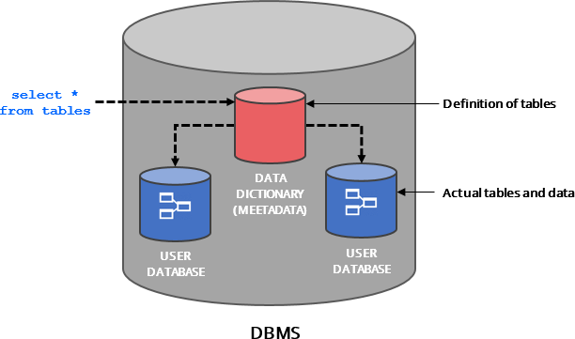
1. Self-describing nature of a database system
(METADATA)

Slide 18
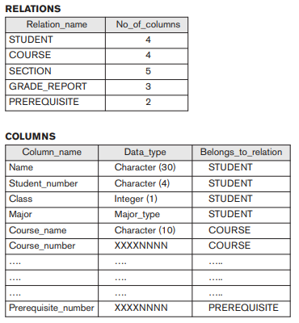
An example of a database catalog for the database

Slide 19
2. Insulation between programs and data, and data abstraction
In traditional file processing, the structure of data files is embedded in the application programs, so any changes to the structure of a file may require changing all programs that access that file.
DBMS provides program-data independence property i.e. The structure of data files is stored in the DBMS catalog separately from the access programs.
Some object oriented databases provides program-operation independence, an operation as two parts one is interface(signature) and the other is implementation(or method). Interface can be changed without changing the implementation
The characteristic that allows program-data independence and program-operation independence is called data abstraction.

Slide 20
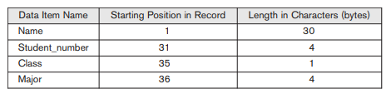
A DBMS provides users with a conceptual representation of data that does not include many of the details of how the data is stored or how the operations are implemented
Internal storage format for a STUDENT record, based on the database catalog

Slide 21
3. Support of Multiple Views of the Data
A database typically has many types of users, each of whom may require a different perspective or view of the database.
A view may be a subset of the database or it may contain virtual data that is derived from the database files but is not explicitly stored.

Slide 22





Implementers of the Application
Different Users of the Application
CEO
Data Analysis
1. Loss/Profit Yearly
2. Project Details etc
Developers
Managers
Projects
Data base
Employees
Profile
Projects
Office Staff
Billing
Salary etc

Slide 23
4. Sharing of Data and Multiuser Transaction Processing
A multiuser DBMS, as its name implies, must allow multiple users to access the database at the same time.
This is essential if the data for multiple applications is to be integrated and maintained in a single database.
The DBMS must include concurrency control software to ensure that several users trying to update the same data do so in a controlled manner so that the result of the updates is correct.

Slide 24
Advantages of Using the DBMS Approach
Controlling redundancy
Sharing of data among multiple users.
Restricting unauthorized access to data.
Providing persistent storage for program
Providing Storage Structures and Search Techniques for Efficient Query Processing
Providing backup and recovery services.
Providing multiple interfaces to different users.
Representing complex relationships among data.
Enforcing integrity constraints on the database.
Drawing Inferences and Actions using rules

Slide 25
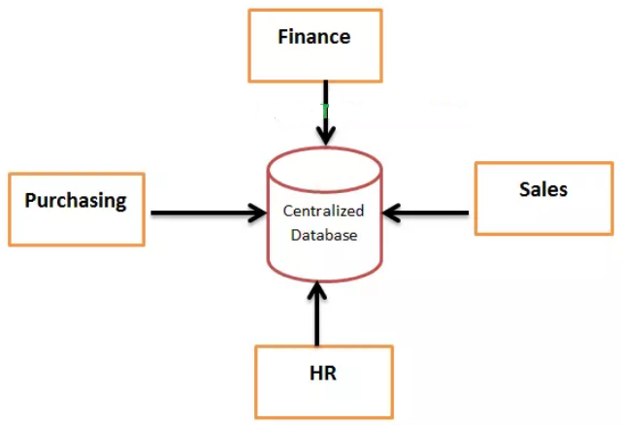
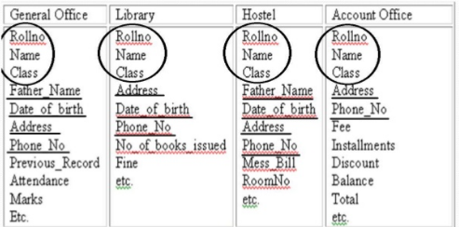
1. Controlling redundancy
Redundancy is storing the same data multiple times at several places, this leads to several problems,
First, It leads to duplication of efforts.
Second, Storage space is wasted.
Third, files that represent the same data may become be inconsistent.
However, in practice, it is sometimes necessary to use controlled redundancy to improve the performance of queries.

Slide 26

2. Restricting unauthorized access to data
When multiple users share a large database, it is likely that most users will not be authorized to access all information in the database.
A DBMS should provide a security and authorization subsystem, which the DBA uses to create accounts and to specify account restrictions and privileges.
Database

Slide 27
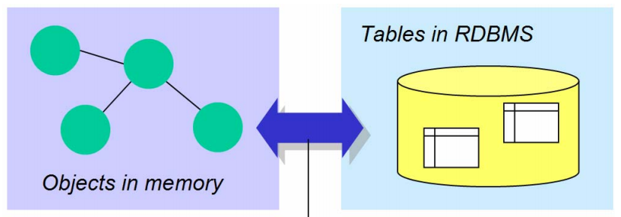
3. Providing persistent storage for program objects
Object Oriented Databases can be used to provide persistent storage for program objects and data structures.
Programming languages typically have complex data structures, such as structs or class definitions in C++ or Java.
Impedance mismatch is nothing but mismatch of data structures wrt DBMS and Programming languages, which requires conversion.

Slide 28
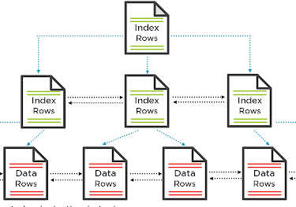
4. Providing Storage Structures and Search Techniques for Efficient Query Processing
Auxiliary files called indexes are often used for this purpose. Indexes are typically based on tree data structures or hash data structures that are suitably modified for disk search.
Auxiliary files called indexes are often used for this purpose. Indexes are typically based on tree data structures or hash data structures that are suitably modified for disk search.
DBMS has Buffering Module to keep some data in main memory.
The query processing and optimization
module of the DBMS is responsible
for choosing an efficient query
execution plan for each query
based on the existing storage structures.

Slide 29
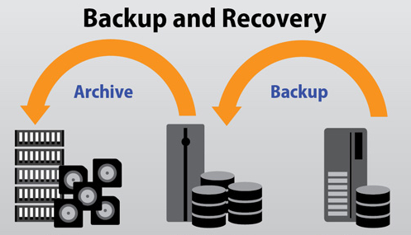
5. Providing Backup and Recovery
A DBMS must provide facilities for recovering from hardware or software failures.
The backup and recovery subsystem of the DBMS is responsible for recovery.
Disk Back up is important in case of catastrophic disk failures.

Slide 30

6. Providing Multiple User Interfaces
Command codes for parametric users
Menu-driven interfaces and natural language interfaces for standalone users
Forms
Query languages for casual users
Database
Programming language interfaces
for application programmers
Mobile apps

Slide 31
7. Representing Complex Relationships among Data
A DBMS must have the capability to represent a variety of complex relationships among the data, to define new relationships as they arise, and to retrieve and update related data easily and efficiently.
8. Enforcing Integrity Constraints
The simplest type of integrity constraint involves specifying a data type for each data item.
Similarly there are referential integrity key or uniqueness constraint.
A data item may be entered erroneously and still satisfy the specified integrity constraints, DBMS can’t handle such things.

Slide 32
9.Permitting Inferencing and Actions Using Rules and Triggers
Some database systems provide capabilities for defining deduction rules for inference new information from the stored database facts.
A trigger is a form of a rule activated by updates to the table, which results in performing some additional operations to some other tables, sending messages, and so on. More involved procedures to enforce rules are popularly called stored procedures.
10.Additional Implications of Using the Database Approach
Potential for Enforcing Standards
Reduced Application Development Time
Flexibility
Availability of Up-to-Date Information

Slide 33
Data Models, Schemas, and Instances
Data abstraction generally refers to the suppression of
details of Data organization and storage, and the highlighting of the essential features for an improved understanding of Data.
Data model—a collection of concepts that can be used to describe the structure of a Database—provides the necessary means to achieve this abstraction.
The Data in the Database at a particular moment in time is called a Database state or snapshot. It is also called the current set of occurrences or instances in the Database.
The description of a Database is called the Database schema, which is specified during Database design and is not expected to change frequently.

Slide 34
Categories of Data Models
High-level or conceptual Data models: Provide concepts that are close to the way many users perceive Data. Conceptual Data models use concepts such as entities, attributes, and relationships.
2. Low-level or physical Data models: Provide concepts that
describe the details of how Data is stored on the computer
storage media, typically magnetic disks.
3. Representational(or implementation) Data models: Provide
concepts that may be easily understood by end users but
that are not too far removed from the way Data is organized
in computer storage.

Slide 35
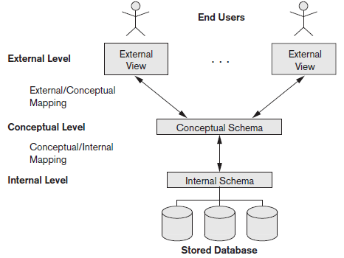
Three-Schema Architecture
The goal of three schema architecture is to separate the user applications from the physical
database

Slide 36
Three-Schema Architecture and Data Independence
The internal level has an internal schema, which describes the physical storage structure of the Database. The internal schema uses a physical Data model and describes the complete details of Data storage and access paths for the Database.
The conceptual schema hides the details of physical storage structures and concentrates on describing entities, Data types, relationships, user operations, and constraints. Usually, a representational Data model is used to describe the conceptual schema.
The external or view level includes a number of external schemas or user views. Each external schema describes the part of the Database that a particular user group is interested in and hides the rest of the Database from that user group.

Slide 37
Data Independence
Data independence: It is defined as the capacity to change the schema at one level of a Database system without having to change the schema at the next higher level
Logical Data independence is the capacity to change the conceptual schema without having to change external schemas or application programs.
2. Physical Data independence is the capacity to change
the internal schema without having to change the
conceptual schema. Hence, the external schemas need
not be changed as well.

Slide 38
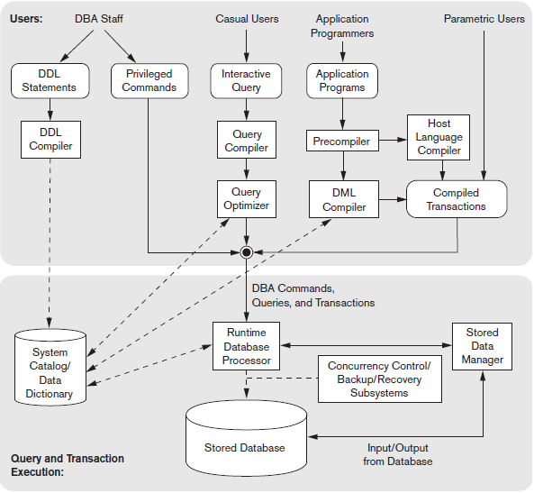
DBMS
Architecture
Figure: Component modules of a DBMS and their interactions.

Slide 39
Figure illustrates, in a simplified form, the typical DBMS components. The figure is divided into two parts. The top part of the figure refers to the various users of the database environment and their interfaces. The lower part shows the internal modules of the DBMS responsible for storage of data and processing of transactions.
The top part of Figure shows interfaces for the DBA staff, casual users who work with interactive interfaces to formulate queries, application programmers who create programs using some host programming languages, and parametric users who do data entry work by supplying parameters to predefined transactions. The DBA staff works on defining the database and tuning it by making changes to its definition using the DDL and other privileged commands.
The DDL compiler processes schema definitions, specified in the DDL, and stores descriptions of the schemas (meta-data) in the DBMS catalog.
In the lower part of Figure 2.3, the runtime database processor executes (1) the privileged commands, (2) the executable query plans, and (3) the canned transactions with runtime parameters. It works with the system catalog and may update it with statistics. It also works with the stored data manager, which in turn uses basic operating system services for carrying out low-level input/output (read/write) operations between the disk and main memory. The runtime database processor handles other aspects of data transfer, such as management of buffers in the main memory.

